Slide 1
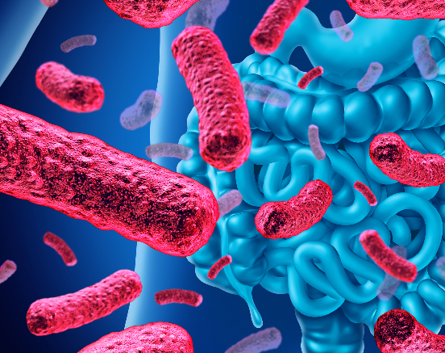
Impact of gut microbiota on emotional behavior
Chinenye Izuegbunam
25th Sept. 2020

Slide 2
Theme
Gut microbiota influence brain function and behaviour through the “microbiota-gut-brain axis”
Impact of depression microbiota on germfree mice
Impact of indole overproduction on stressed germfree mice

Slide 3
Characters
Major depressive disorder (MDD)
Gut-brain Axis
Indole
Tryptophan

Slide 4
Major depressive disorder (MDD)
Characterized by
depressed mood
loss of interest in daily activities for at least two weeks
impairs important functioning
E.g. social, occupational, educational
Affects millions of individuals globally.
~ 16.1 million American adults
~6.7% of the U.S. population age 18 and older in a year
More women than men

Slide 5
Treatment options for MDD
Traditional antidepressants
SSRIs
Ketamine
Most antidepressants require chronic administration for long term effect
Psychedelics based drugs are being developed.
What about the gut-mediated therapy option?

Slide 6
Traditional therapies
Regulate the brain
Influence gut microbiota
The first antidepressant, isoniazid, was originally used to treat Mycobacterium tuberculosis
SSRIs can inhibit the proliferation of Gram-positive bacteria
ketamine can inhibit the proliferation of Staphylococcus, Enterococcus, and Candida albicans.
Their antidepressant effects are probably partly related with the regulation of the microbiota–gut–brain axis

Slide 7
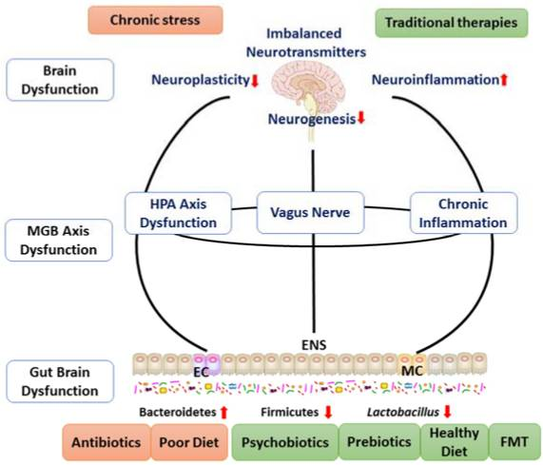
Targeting gut microbiota as a viable therapeutic strategy for novel antidepressant
https://www.ncbi.nlm.nih.gov/pmc/articles/PMC6032096/

Slide 8
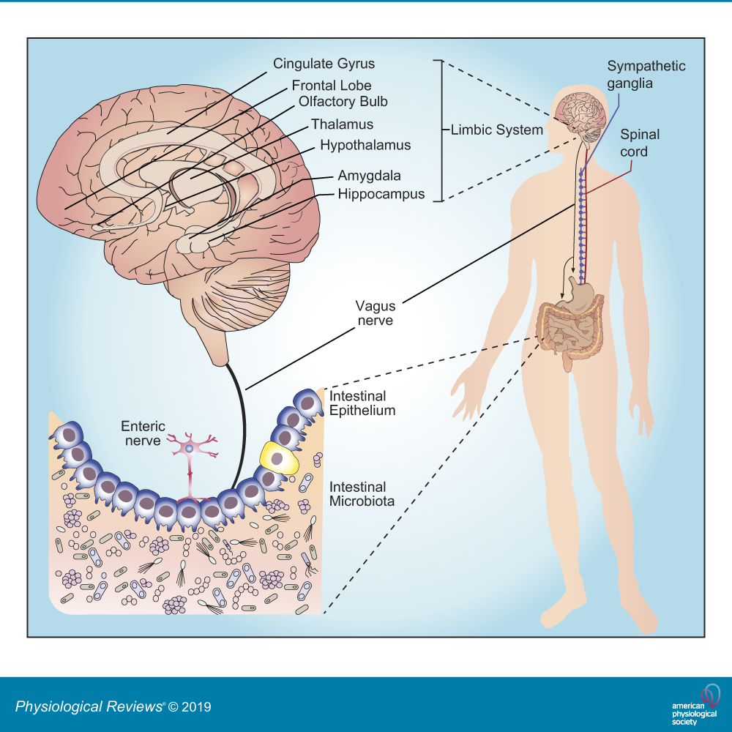
Gut-Brain Axis
The gut and the brain “talk” through
Enteric nervous system
Vagus nerve
Biochemical molecules
neurotransmitters
https://doi.org/10.1152/physrev.00018.2018

Slide 9
Purpose
Explore gut microbiome role in depression
Its contribution to developing treatment for depression

Slide 10
Hypothesis
Dysbiosis of gut microbiota may be a contributory factor to the development of depression
Excessive production of indole by the gut microbiota may enhance the behavioral impairments induced by a chronic exposure to environmental stressors

Slide 11
What don’t we know?
Is depression-like behavior transmissible via the gut microbiome?
Is there a link between the ‘microbiota-gut-brain axis’ and depression-like behavior?
Does changes in gut microbiota metabolism contribute to changes in patho-physiological processes ?

Slide 12
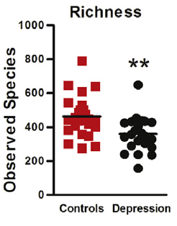
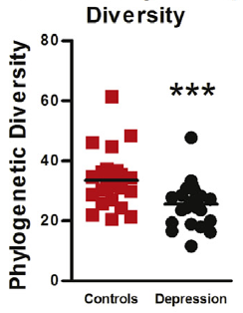
MDD patients display disturbances in their gut microbiomes

Slide 13
Relative abundance of key gut microbiota phyla in patients
Notes:
The relative abundances of Actinobacteria and Bacteroidetes were significantly changed in MDD patients and healthy controls. (c) There was no difference in the overall relative abundance of Firmicutes between MDD patients and healthy controls. Data are presented as means ± standard errors of the mean. From supp data. Zeng 2016 The relative abundances of Actinobacteria and Bacteroidetes were significantly changed in MDD patients and healthy controls. (c) There was no difference in the overall relative abundance of Firmicutes between MDD patients and healthy controls. Data are presented as means ± standard errors of the mean. From supp data. Zeng 2016 The relative abundances of Actinobacteria and Bacteroidetes were significantly changed in MDD patients and healthy controls. (c) There was no difference in the overall relative abundance of Firmicutes between MDD patients and healthy controls. Data are presented as means ± standard errors of the mean. From supp data. Zeng 2016

Slide 14
Does the microbiota affect the emotional behavior of Germfree mice?
Depression-like behavior
FST and TST two weeks post fecal microbiota transplantation (FMT)
Anxiety like behaviour
OFT, two weeks post fecal microbiota transplantation (FMT)

Slide 15
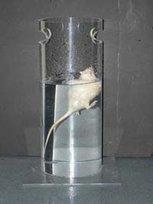
Forced swim test
Response to the threat of drowning
Interpreted as measuring susceptibility to negative mood

Slide 16
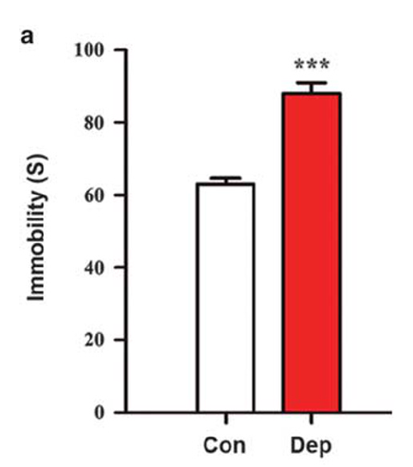
‘Depression microbiota’ recipients displayed depression-like behaviour
FST , Two-week post FMT
An increased duration of immobility in the FST

Slide 17
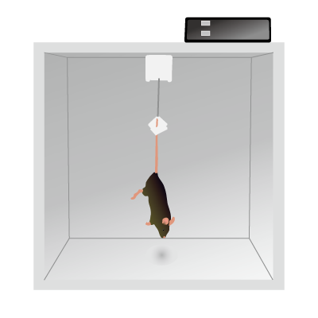
Tail suspension test
Lasts for six or more minutes.
Mice initially struggle to face upward and climb to a solid surface.
Longer periods of immobility are characteristic of a depressive-like state.

Slide 18
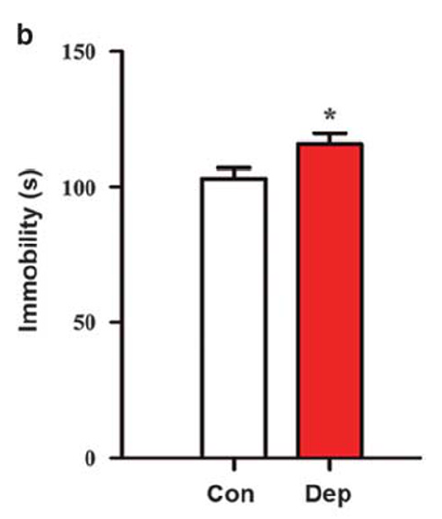
‘Depression microbiota’ recipients displayed depression-like behaviour
TST, Two week post FMT
Increased of immobility in the TST

Slide 19
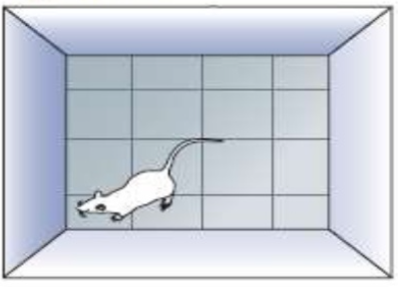
Open field test
Decreased center motion distance in the OFT, is indicative of anxiety-like behavior

Slide 20
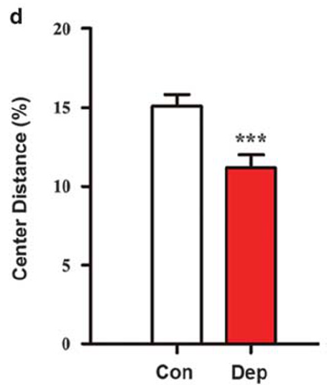
‘Depression microbiota’ recipients displayed anxiety-like behavior
Decreased center motion distance in the OFT

Slide 21
Tryptophan

Slide 22
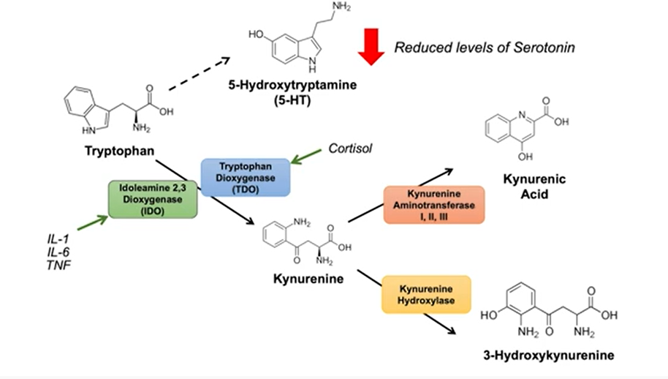
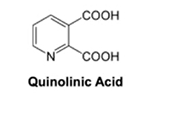
Tryptophan and Kynurenine pathway
Neurotoxic effects
Involved in psychiatric disorder

Slide 23
Cytokine: proinflammatory profile

Slide 24
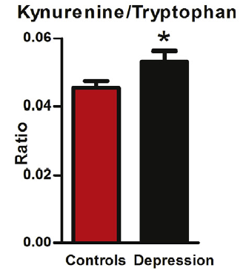
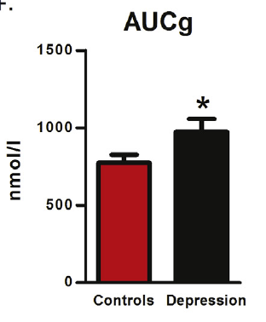
Increased kynurenine/tryptophan ratio and cortisol in patients

Slide 25
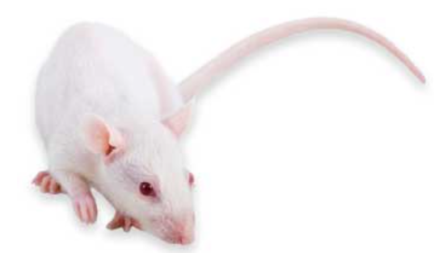
Does these microbiota affect the emotional behavior in adult male Sprague Dawley rats ?
Sucrose preference
Open field
Elevated plus maze
Forced swim test

Slide 26
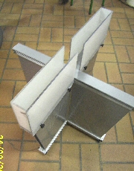
Elevated plus maze
A test for anxiety
EPM - two open arms and two enclosed arms
More time in
closed arm=anxiety-like
open arm= anxiolytic effect

Slide 27
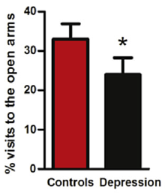
The ‘depression microbiota’ recipients exhibits anxiety-like behavior

Slide 28
The ‘depression microbiota’ recipients exhibits anxiety-like behavior

Slide 29
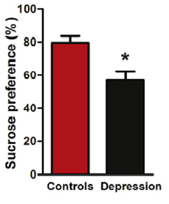
The ‘depression microbiota’ recipients displays anhedonia-like behavior
The ‘depression microbiota’ recipients displays anhedonia -like behavior

Slide 30
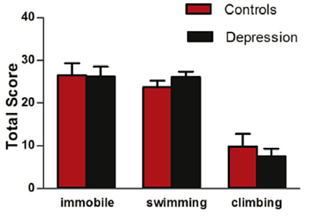
FST- No depression-like behavior

Slide 31
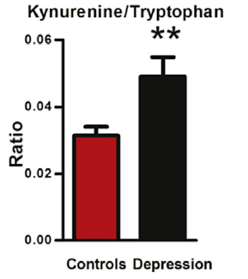
Depression is associated with dysregulated tryptophan metabolism
Patients
Rat

Slide 32
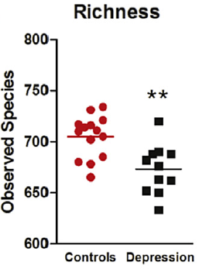
Altered gut microbiota richness
Patients
Rat

Slide 33
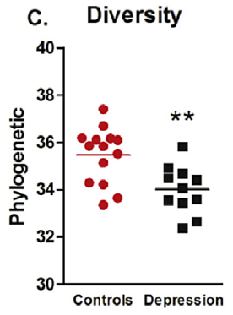
Altered gut microbiota diversity
Patients
Rat

Slide 34
Summary
Microbiota signature from depressed patients induced the development of some of the physiological and behavioural features of the depressive phenotype in rats
Gut microbiota could play a causal role in the complex mechanisms underlying the development of depression.
Immune mediated mechanism may account for the development of depressive phenotype
Activation of the kynurenine pathway

Slide 35
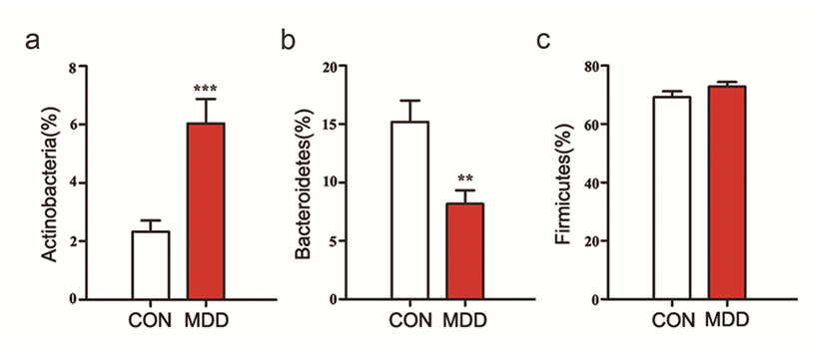
So, what next?
Does changes in gut microbiota metabolism contribute to changes in patho-physiological processes ?

Slide 36
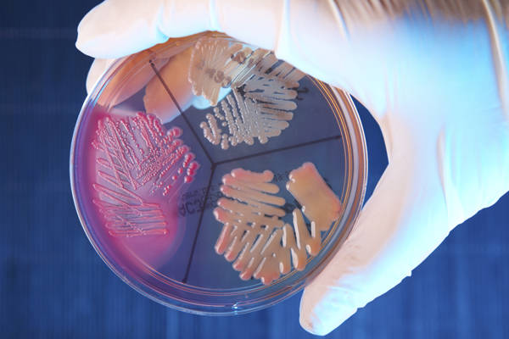
Few major drivers of microbiota-gut-brain axis (Bacteroidetes)
Bacteroidetes are symbiotic species
highly abundant in intestines
They perform metabolic conversions
Produce favourable metabolites
SCFAs, correlated with reducing inflammation
Bacteroides organisms are the anaerobic counterpart of E. coli.
https://www.jax.org/news-and-insights/jax-blog/2015/may/the-skinny-on-gut-microbes-and-your-health#

Slide 37
Tryptophan metabolism by human gastrointestinal microbiota
Indole is widely distributed in the natural environment and can be produced by a variety of bacteria.
Intercellular signal molecule

Slide 38
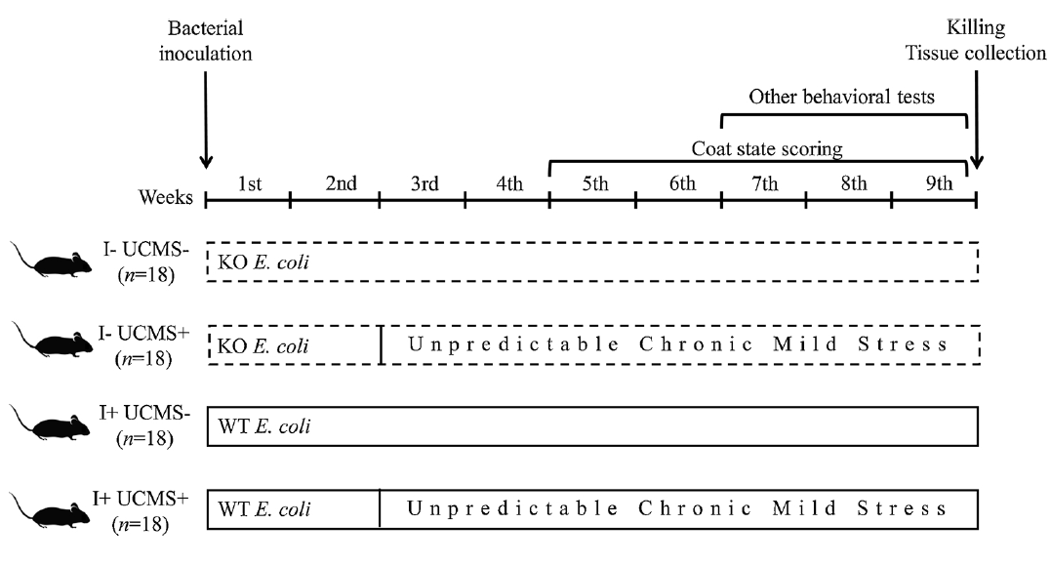
UCMS did not affect indole concentration
UCMS+GF male mice
UCMS – mice as control

Slide 39
Behavioral test
Depression-like behavior assessment
Coat state
nesting
splash test
Sucrose
Tail suspension
Anxiety-like behavior assessment
Novelty
elevated plus maze

Slide 40
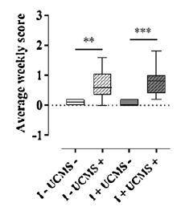
Indole increase the effect of UCMC on in self-grooming
The coat state deteriorated progressively in both indole and non-indole producing mice

Slide 41
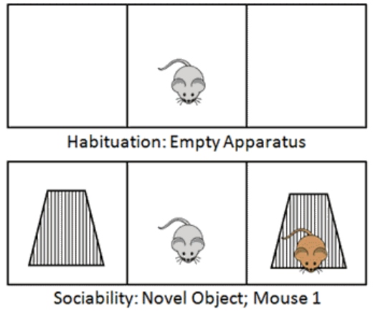
Three-Chamber Sociability Task
Habituation
Introduction of novel object/mice
Sociability
Used in Novelty test

Slide 42
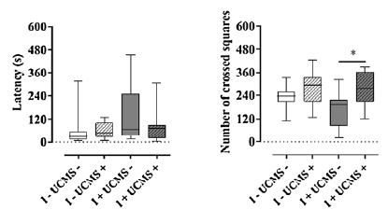
Novelty test
Indole enhanced locomotor activity

Slide 43
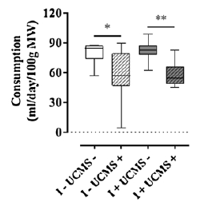
UCMS leads to anhedonic behavior
Anhedonia in both indole and non-indole producing mice

Slide 44
No sig difference
nesting
tail suspension
splash test
elevated plus maze

Slide 45
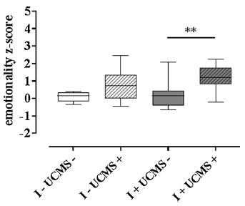
Overall emotionality
No significant difference in 75 % of all the test
The production of indole by the gut microbiota increased the adverse effects UCMS+ (chronic mild stress) on emotional behaviors.

Slide 46
Summary
Indole production did not significantly influence the behavior of mice when tests were considered individually
Indole production did not modify the emotional behavior of the non-stressed mice

Slide 47
Can overproduction of indole influence the biosynthesis of stress hormones?
Expression of genes involved in stress-related hormone biosynthesis
Corticosterone in the zona fasciculata of the adrenal cortex
21α-hydroxylase (Cyp21a1) :hydroxylates steroids at the C21 position and is involved in biosynthesis of aldosterone and cortisol
11β-hydroxylase (Cyp11b1): involved in the biosynthesis of adrenal corticosteroids
Hsd3b: Catalyzes the biosynthesis of progesterone

Slide 48
No significant change of the expression of stress related hormones

Slide 49
Can overproduction of indole influence the biosynthesis of stress hormones?
For catecholamines produced by the adrenal medulla the expression of genes encoding
Tyrosine hydroxylase (Th):catalyzes the conversion of the amino acid L-tyrosine to L-3,4-dihydroxyphenylalanine
dopamine β-hydroxylase (Dbh): converts dopamine to norepinephrine, (neurotransmitters) that transmit signals between nerve cells
Phenylethanolamine N-methyltransferase (Pnmt): converts norepinephrine to epinephrine

Slide 50
Exposure to the UCMS led to a significant increase of the expression of the Pnmt gene in “I+” mice but not in “I−” mice.
Why was only Pnmt mRNA found in high abundance?

Slide 51
Summary
Chronic indole production by the gut microbiota increased the vulnerability of male mice to the adverse effects of chronic mild stress on emotional behaviors
It also targeted catecholamine biosynthetic pathway of the adrenal medulla, which plays a pivotal role in body’s physiological adaptation to stressful events.

Slide 52
Significance/conclusion
Uncovers the pathologic mechanism(s) underlying depression as well as revealing the need for innovative gut-mediated therapies for depression
Advances the concept that targeting the gut microbiota may be a viable therapeutic strategy for novel antidepressant development in sub groups of depressed patients and may augment depression prevention strategies.

